Slide 1
Deep Learning

Slide 2
Slide credits
Most of these slides were adapted from:
Hung-yi Lee (National Taiwan University)
Kris Kitani (Carnegie Mellon University).
Noah Snavely (Cornell University).
Fei-Fei Li (Stanford University).

Slide 3
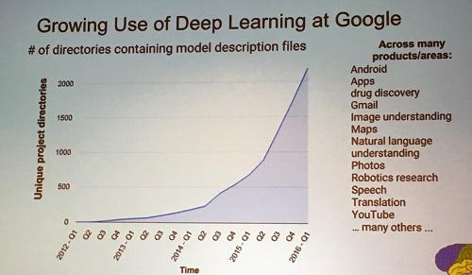
Deep learning attracts lots of attention.
I believe you have seen lots of exciting results before.
Deep learning trends at Google. Source: SIGMOD 2016/Jeff Dean

Slide 4
Ups and downs of Deep Learning
1958: Perceptron (linear model)
1969: Perceptron has limitation
1980s: Multi-layer perceptron
Do not have significant difference from DNN today
1986: Backpropagation
Usually more than 3 hidden layers is not helpful
1989: 1 hidden layer is “good enough”, why deep?
2006: RBM initialization
2009: GPU
2011: Start to be popular in speech recognition
2012: win ILSVRC image competition
2015.2: Image recognition surpassing human-level performance
2016.3: Alpha GO beats Lee Sedol
2016.10: Speech recognition system as good as humans

Slide 5
Deep learning Giant

Slide 6
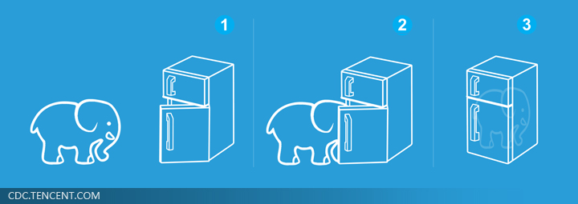
Three Steps for Deep Learning
Step 1: define a set of function
Step 2: goodness of function
Step 3: pick the best function
Neural
Network
Deep Learning is so simple ……

Slide 7
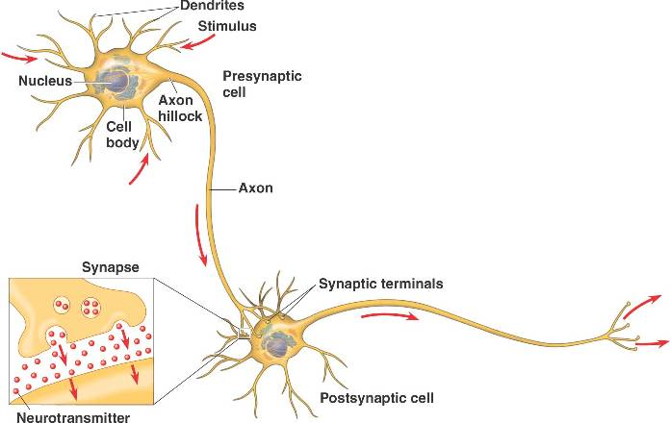
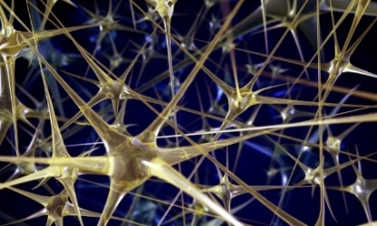
Neural Network
“Neuron”
Neural Network
Different connection leads to different network structures
Network parameter $θ$: all the weights and biases in the “neurons”

Slide 8
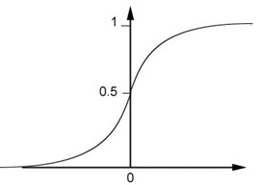
Fully Connect Feedforward Network
1
4
0.98
1
-2
1
-1
-2
0.12
-1
1
0
Sigmoid Function

Slide 9
Fully Connect Feedforward Network
1
4
0.98
2
0.86
3
0.62
1
-2
-1
-1
1
0
-2
-1
-2
0.12
-2
0.11
-1
0.83
-1
1
-1
4
0
0
2

Slide 10
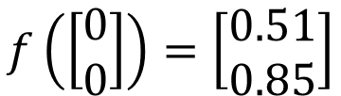
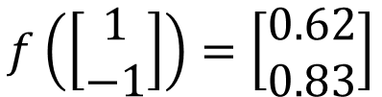
Fully Connect Feedforward Network
1
0.73
2
0.72
3
0.51
0
-2
-1
-1
1
0
-2
-1
0.5
-2
0.12
-1
0.85
0
1
-1
4
0
0
2
This is a function.
$$f\left(\left[\begin{matrix}1 \\ −1\end{matrix}\right]\right)=\left[\begin{matrix}0.62 \\ 0.83\end{matrix}\right]$$
$$f\left(\left[\begin{matrix}0 \\ 0\end{matrix}\right]\right)=\left[\begin{matrix}0.51 \\ 0.85\end{matrix}\right]$$
Input vector, output vector
Given network structure, define a function set

Slide 11
Fully Connect Feedforward Network
neuron
Input
Layer 1
Layer 2
Layer L
Output
……
y₁
……
y₂
……
……
……
……
……
……
y_{M}
Input Layer
Output Layer
Hidden Layers

Slide 12
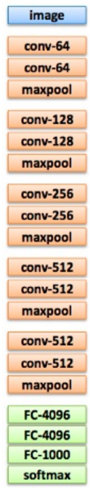
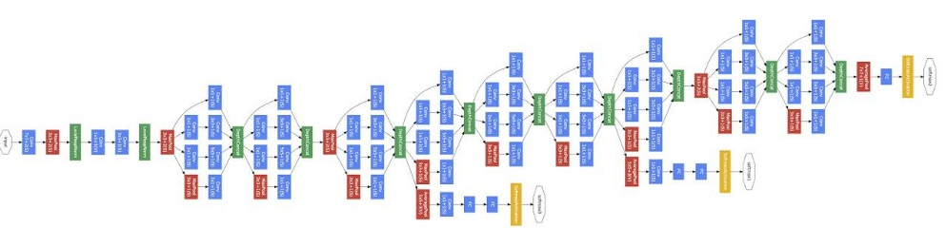
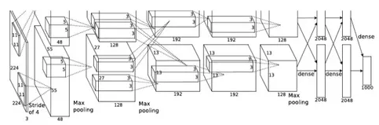
Deep = Many hidden layers
22 layers
http://cs231n.stanford.edu/slides/winter1516_lecture8.pdf
19 layers
8 layers
6.7%
7.3%
16.4%
AlexNet (2012)
VGG (2014)
GoogleNet (2014)

Slide 13
Deep = Many hidden layers
152 layers
Special
structure
Ref: https://www.youtube.com/watch?v=dxB6299gpvI
3.57%
7.3%
6.7%
16.4%
AlexNet (2012)
VGG
(2014)
GoogleNet
(2014)
Residual Net
(2015)

Slide 14
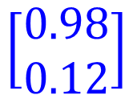


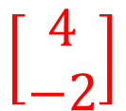

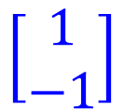

Matrix Operation
1
4
0.98
1
-2
1
-1
-2
0.12
-1
1
0
$$\left[\begin{matrix}1 & −2 \\ −1 & 1\end{matrix}\right]$$
$$\left[\begin{matrix}1 \\ −1\end{matrix}\right]$$
$$\left[\begin{matrix}1 \\ 0\end{matrix}\right]$$
$$=$$
$$\left[\begin{matrix}0.98 \\ 0.12\end{matrix}\right]$$
$$σ\left( \right)$$
$$+$$
$$\left[\begin{matrix}4 \\ −2\end{matrix}\right]$$

Slide 15



Neural Network
……
y₁
W¹
W²
W^{L}
……
y₂
b¹
b²
b^{L}
……
……
……
……
……
x
a¹
a²
y
……
y_{M}
W¹
x
b¹
+
$$σ\left( \right)$$
a¹
b²
W²
+
$$σ\left( \right)$$
W^{L}
b^{L}
a^{L-1}
+
$$σ\left( \right)$$

Slide 16


Neural Network
……
y₁
W¹
W²
W^{L}
……
y₂
b¹
b²
b^{L}
……
……
……
……
……
x
a¹
a²
y
……
y_{M}
y
x
Using parallel computing techniques to speed up matrix operation
$$=f\left( \right)$$
W^{L}
…
W²
W¹
x
b¹
b²
…
b^{L}
+
+
+
$$σ\left( \right)$$
$$=σ\left( \right)$$
$$σ\left( \right)$$

Slide 17
Output Layer as Multi-Class Classifier
Feature extractor replacing feature engineering
……
y₁
……
y₂
Softmax
……
……
……
……
……
……
y_{M}
Input Layer
Output Layer
= Multi-class Classifier
Hidden Layers

Slide 18
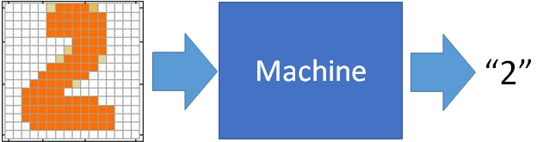
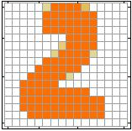
Example Application
Input
Output
y₁
is 1
0.1
y₂
is 2
0.7
The image is “2”
……
……
……
y₁₀
0.2
is 0
16 x 16 = 256
Ink → 1
No ink → 0
Each dimension represents the confidence of a digit.

Slide 19
Example Application
Handwriting Digit Recognition
y₁
is 1
Machine
y₂
is 2
Neural
Network
“2”
……
……
……
y₁₀
is 0
What is needed is a function ……
Input:
256-dim vector
output:
10-dim vector

Slide 20
Example Application
Input
Layer 1
Layer 2
Layer L
Output
……
y₁
is 1
……
A function set containing the candidates for
Handwriting Digit Recognition
y₂
is 2
“2”
……
……
……
……
……
……
……
y₁₀
is 0
Input Layer
Output Layer
Hidden Layers
You need to decide the network structure to let a good function in your function set.

Slide 21
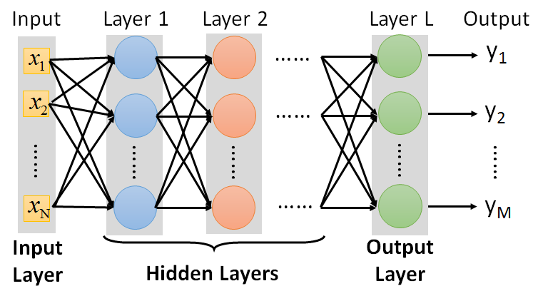
FAQ
Q: How many layers? How many neurons for each layer?
Q: Can the structure be automatically determined?
E.g. Evolutionary Artificial Neural Networks
Q: Can we design the network structure?
Trial and Error
+
Intuition
Convolutional Neural Network (CNN)

Slide 22
Three Steps for Deep Learning
Step 1: define a set of function
Step 2: goodness of function
Step 3: pick the best function
Neural
Network
Deep Learning is so simple ……

Slide 23




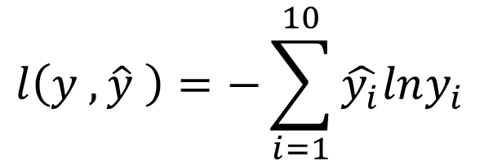


Loss for an Example
target
“1”
……
y₁
$${\hat{y}}_{1}$$
1
……
0
Given a set of parameters
y₂
$${\hat{y}}_{2}$$
Softmax
……
……
……
……
Cross
Entropy
……
……
……
y₁₀
0
$${\hat{y}}_{10}$$
$$y$$
$$\hat{y}$$
$$l\left(y ,\hat{y} \right)=−\sum_{i=1}^{10}{\hat{y_{i}}lny_{i}}$$

Slide 24





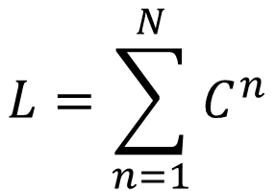
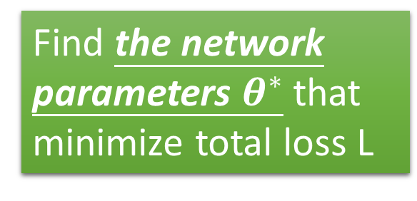







Total Loss
Total Loss:
$$L=\sum_{n=1}^{N}{l^{n}}$$
For all training data …
x¹
NN
y¹
$${\hat{y}}^{1}$$
$$l^{1}$$
NN
Find a function in function set that minimizes total loss L
x²
y²
$${\hat{y}}^{2}$$
$$l^{2}$$
x³
NN
y³
$${\hat{y}}^{3}$$
$$l^{3}$$
……
……
……
……
Find the network parameters $θ^{∗}$ that minimize total loss L
x^{N}
NN
y^{N}
$${\hat{y}}^{N}$$
$$l^{N}$$

Slide 25
Three Steps for Deep Learning
Step 1: define a set of function
Step 2: goodness of function
Step 3: pick the best function
Neural
Network
Deep Learning is so simple ……

Slide 26
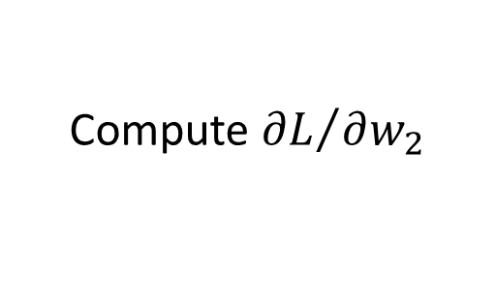
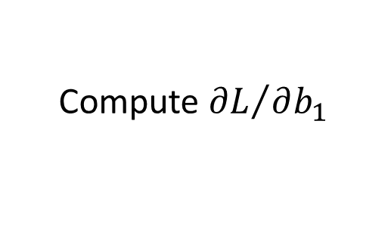
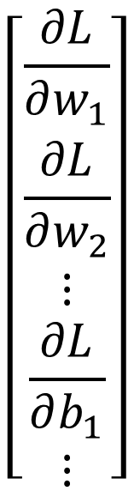
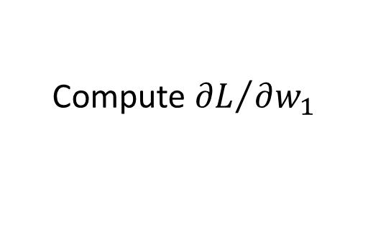





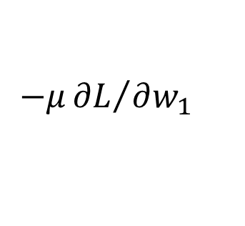
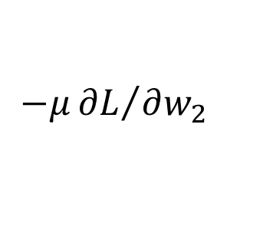
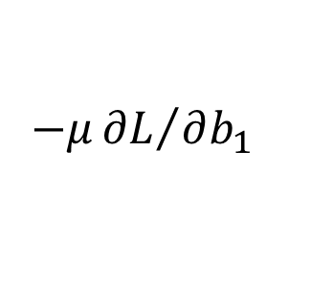
Gradient Descent
$$θ$$
Compute ${∂L}/{∂w_{1}}$
$$\left[\begin{aligned}\frac{∂L}{∂w_{1}} \\ \frac{∂L}{∂w_{2}} \\ ⋮ \\ \frac{∂L}{∂b_{1}} \\ ⋮\end{aligned}\right]$$
$$w_{1}$$
0.2
0.15
$$−μ{∂L}/{∂w_{1}}$$
Compute ${∂L}/{∂w_{2}}$
$$w_{2}$$
-0.1
0.05
$$∇L=$$
$$−μ{∂L}/{∂w_{2}}$$
……
Compute ${∂L}/{∂b_{1}}$
$$b_{1}$$
0.3
0.2
$$−μ{∂L}/{∂b_{1}}$$
……
gradient

Slide 27
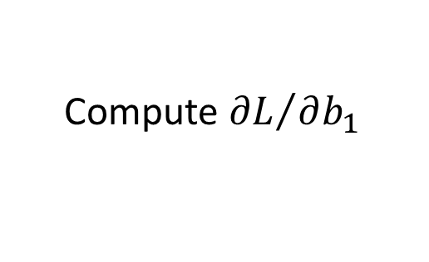
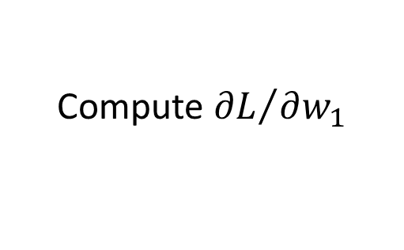
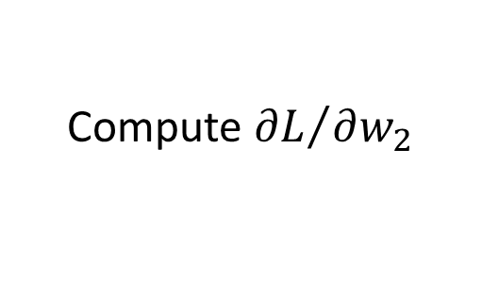
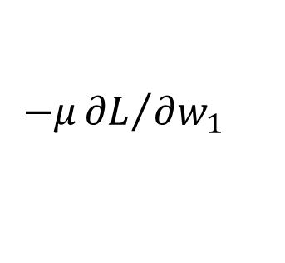
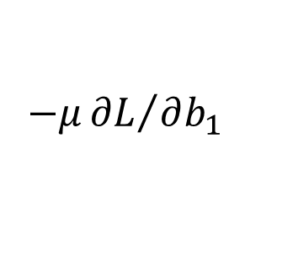
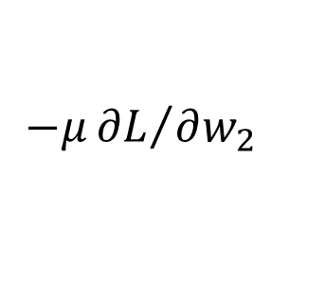
Gradient Descent
$$θ$$
Compute ${∂L}/{∂w_{1}}$
Compute ${∂L}/{∂w_{1}}$
$$w_{1}$$
0.2
0.15
0.09
$$−μ{∂L}/{∂w_{1}}$$
$$−μ{∂L}/{∂w_{1}}$$
……
Compute ${∂L}/{∂w_{2}}$
Compute ${∂L}/{∂w_{2}}$
$$w_{2}$$
-0.1
0.05
0.15
$$−μ{∂L}/{∂w_{2}}$$
$$−μ{∂L}/{∂w_{2}}$$
……
……
Compute ${∂L}/{∂b_{1}}$
Compute ${∂L}/{∂b_{1}}$
$$b_{1}$$
0.3
0.2
0.10
$$−μ{∂L}/{∂b_{1}}$$
$$−μ{∂L}/{∂b_{1}}$$
……
……

Slide 28
Gradient Descent
This is the “learning” of machines in deep learning ……
Even alpha go using this approach.
I hope you are not too disappointed :p

Slide 29








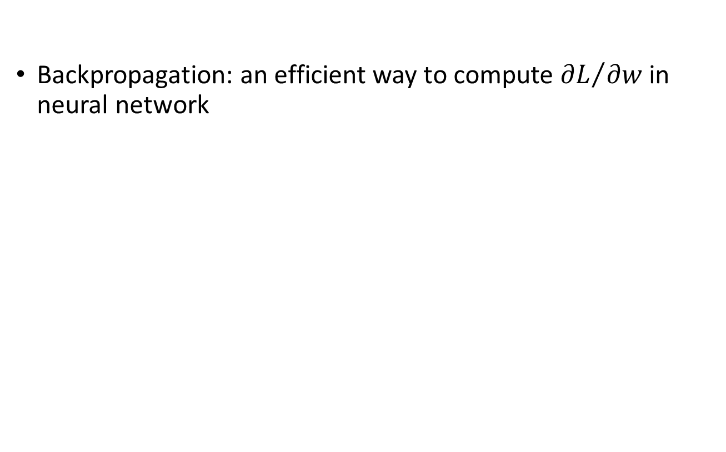
Backpropagation
Backpropagation: an efficient way to compute ${∂L}/{∂w}$ in neural network

